Slide 1
Timeframe
Intro 10 min
Big Data Ecosystem 10 min
Zeppelin Basics 15 min
Object Storage & Hive 15 min
Spark (Angular, Kafka) 30 min
Machine Learning, ADW Connection and Data Frames 20 min
Summary / Q&A 15 min

Slide 3

Sascha Hagedorn
Master of Science (IT University of Copenhagen) – Digital Innovation and Management, Specialization: Data Science
Master Thesis – Deep Learning Model to analyse webshop clickstream data
Joined Oracle last year in august as part of the SE Hub
Oracle Code One – Hands On Lab

Slide 4
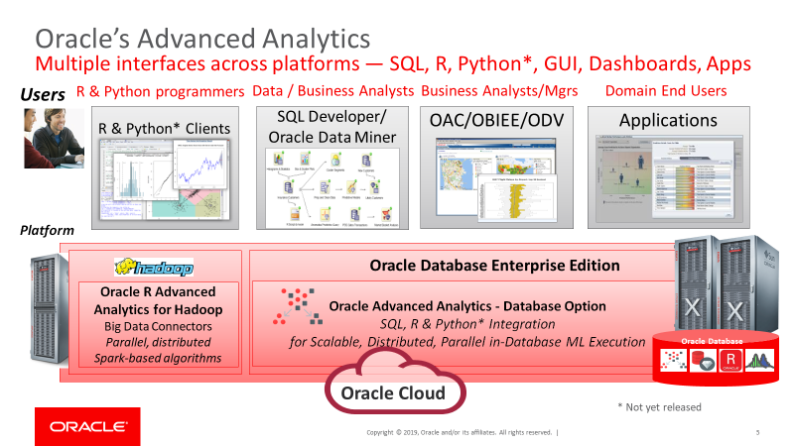
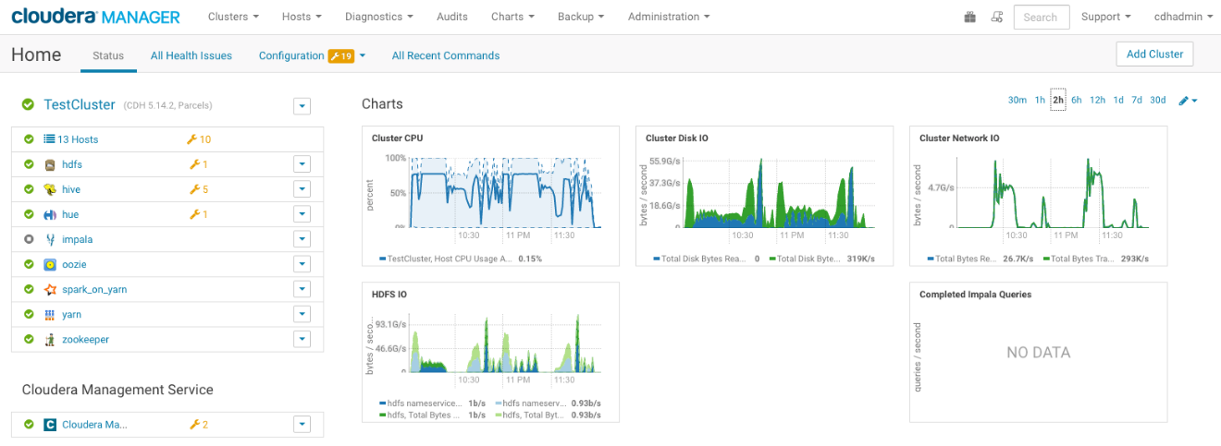
Focus
Machine Learning Solutions
ADW ML (PLSQL/OML4Py)
Python / R
Custom Images
Analytics Cloud
Data Flow
Big Data Service
Data Science Cloud
Data Flow
(Autonomous Data Warehouse)

Slide 5
Agenda
Big Data Ecosystem
Zeppelin Basics
Hive
Spark (Angular, Kafka)
Machine Learning & Data Frames

Slide 7
Big Data Ecosystem

Slide 8







Workshop Components
Hadoop File System (HDFS)
Object Storage
Apache Hive
Apache Zeppelin
Python
Apache Kafka
Apache Spark
Event Hub

Slide 9
Zeppelin
A completely open web-based notebook that enables interactive data analytics
data ingestion
data exploration
Visualization
sharing and collaboration
→ With Python, SQL, Spark and more

Slide 10
Object Storage
Highly durable and available
Unlimited Scale
High Throughput
Integrated to Identity Management
Self-Healing
Server Side Encryption

Slide 11
Hadoop
Framework
distributed processing of large data sets across clusters of computers
Hadoop Distributed File System (HDFS) + processing with MapReduce

Slide 12
Apache Hive
Data warehouse software
Reading
Writing
Managing
→ Datasets in distributed storage via SQL

Slide 13
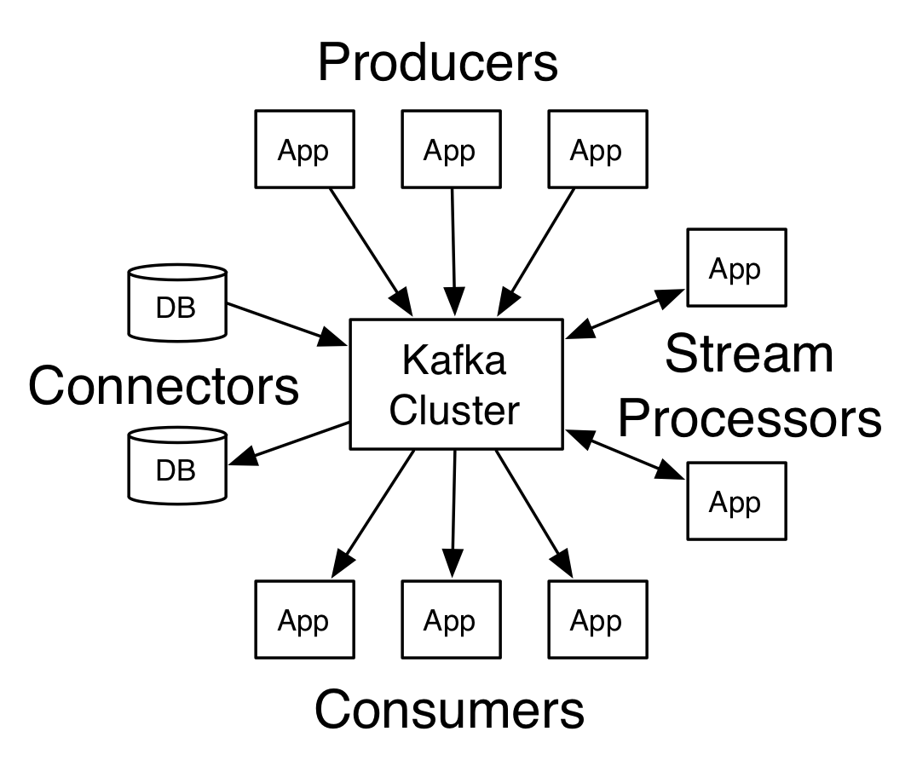
Distributed streaming platform
Publish and subscribe to streams of records, similar to a message queue or enterprise messaging system
Store streams of records in a fault-tolerant durable way
Process streams of records as they occur

Slide 14
unified analytics engine for large-scale data processing
Apache Spark achieves high performance for both batch and streaming data
Write applications quickly in Java, Scala, Python, R, and SQL

Slide 15
Oracle Event Hub
Spin up multiple clusters and create topics in seconds, on demand, and then use it.
Scale Out or Scale In clusters or Add/Remove partitions to elastically react to varying demands of your streaming data.
Choose different cluster configurations depending on your needs.
Use open REST APIs and CLIs to manage, use, and extend the service.

Slide 16
Hands-On

